Slide 1



public safety*
View in Power BI
Last data refresh:
12/08/2020 18:26:30 UTC
Downloaded at:
28/12/2023 23:51:57 UTC

Slide 2
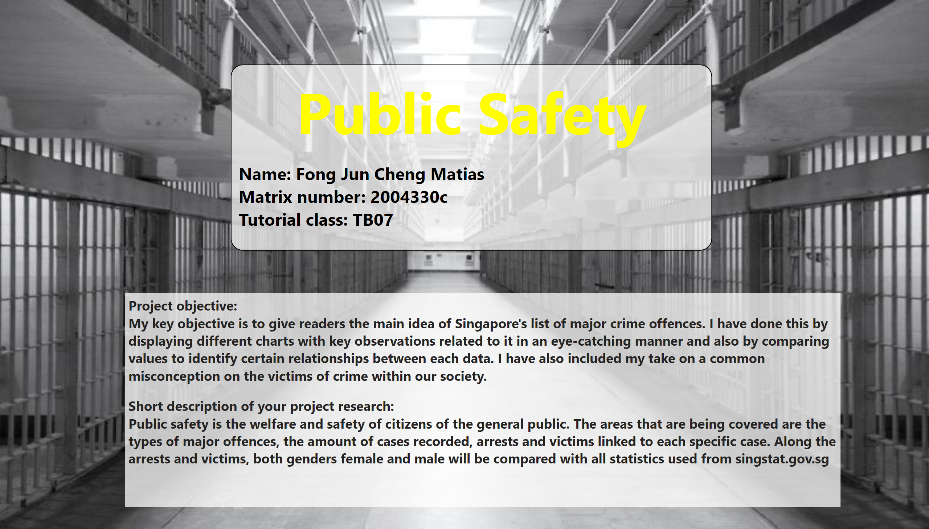
Page 1
Notes:
textbox
No alt text provided
textbox
No alt text provided

Slide 3
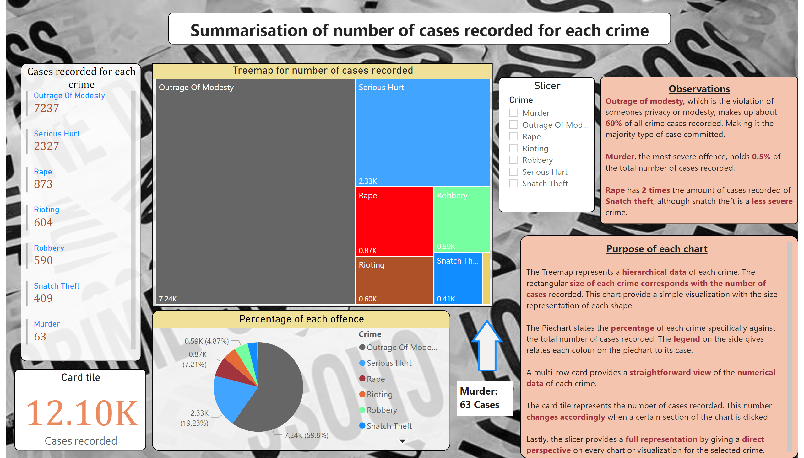
Cases recorded
Notes:
Percentage of each offence
No alt text provided
Card tile
No alt text provided
textbox
No alt text provided
basicShape
No alt text provided
Treemap for number of cases recorded
No alt text provided
Cases recorded for each crime
No alt text provided
textbox
No alt text provided
textbox
No alt text provided
textbox
No alt text provided
Slicer
No alt text provided

Slide 4
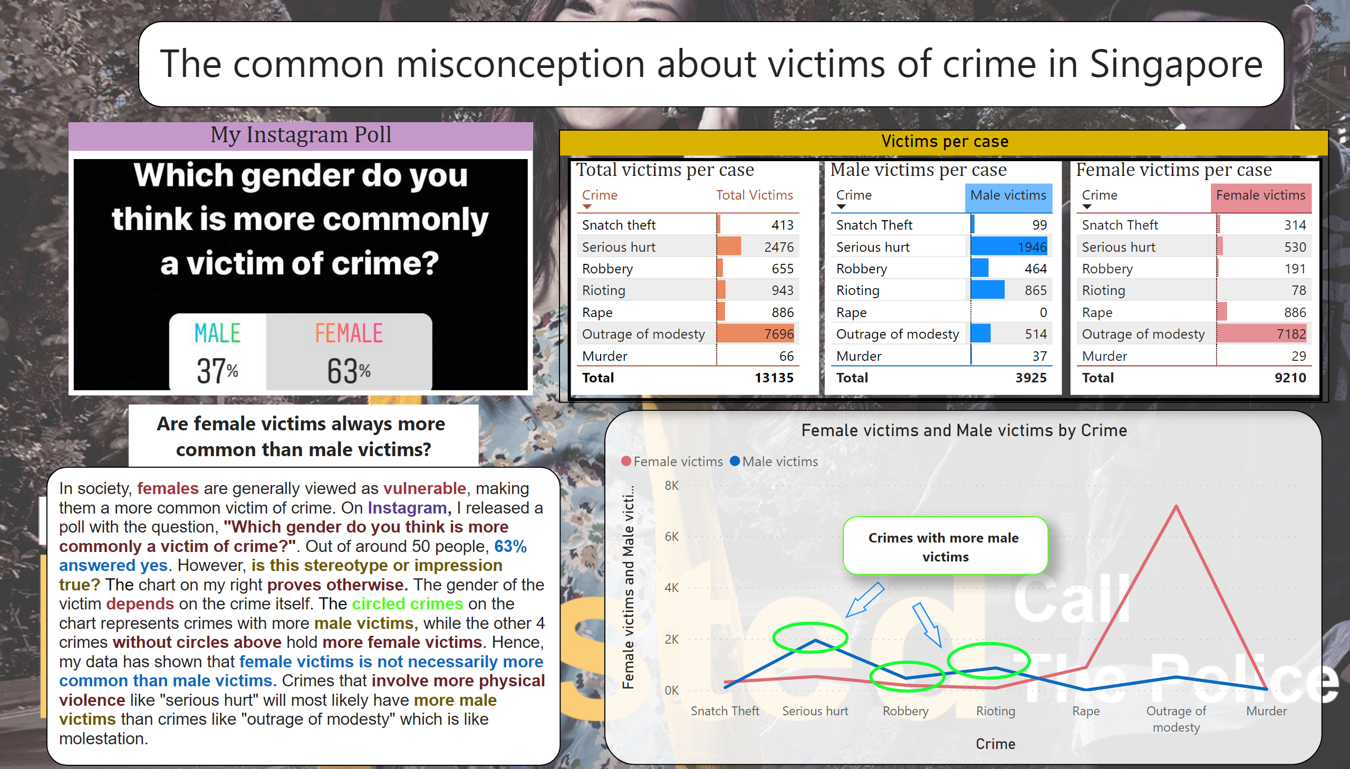
Majority victim
Notes:
lineStackedColumnComboChart
No alt text provided
Female victims per case
No alt text provided
Male victims per case
No alt text provided
textbox
No alt text provided
basicShape
No alt text provided
Total victims per case
No alt text provided
basicShape
No alt text provided
basicShape
No alt text provided
textbox
No alt text provided
My Instagram Poll
No alt text provided
Victims per case
No alt text provided
textbox
No alt text provided
basicShape
No alt text provided
basicShape
No alt text provided
textbox
No alt text provided

Slide 5
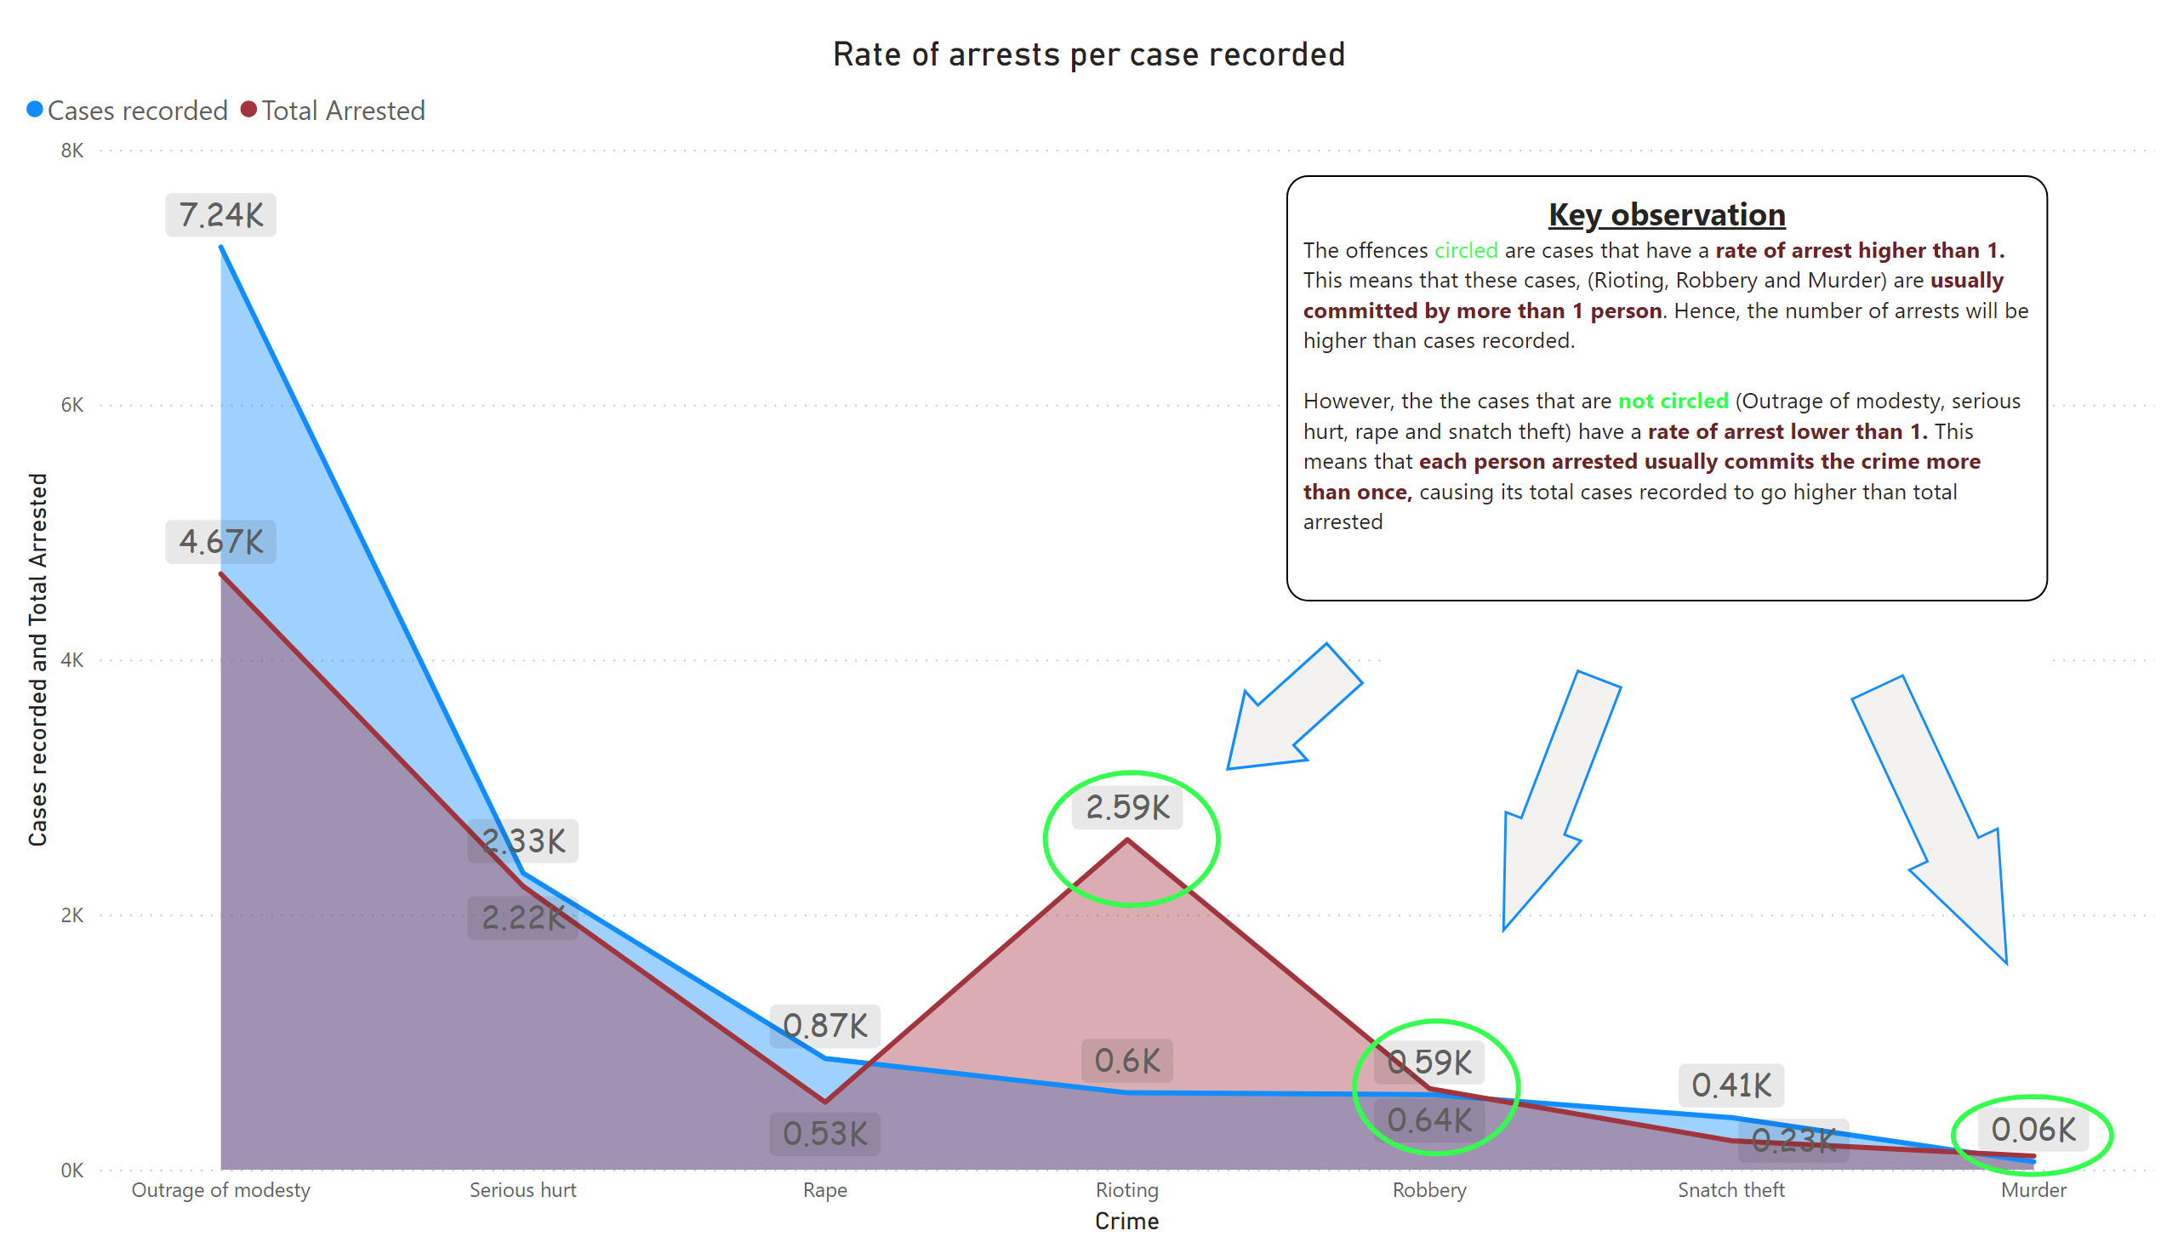
Arrests per case
Notes:
Rate of arrests per case recorded
No alt text provided
textbox
No alt text provided
basicShape
No alt text provided
basicShape
No alt text provided
basicShape
No alt text provided
textbox
No alt text provided
basicShape
No alt text provided
basicShape
No alt text provided
basicShape
No alt text provided

Slide 6
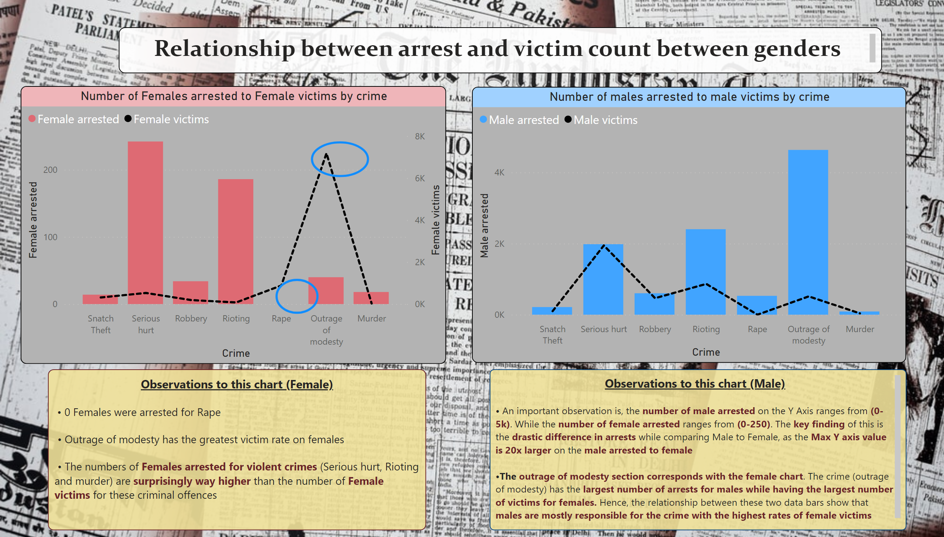
Arrested to victims by gender
Notes:
Number of males arrested to male victims by crime
No alt text provided
Number of Females arrested to Female victims by crime
No alt text provided
basicShape
No alt text provided
basicShape
No alt text provided
textbox
No alt text provided
textbox
No alt text provided
textbox
No alt text provided

Slide 7
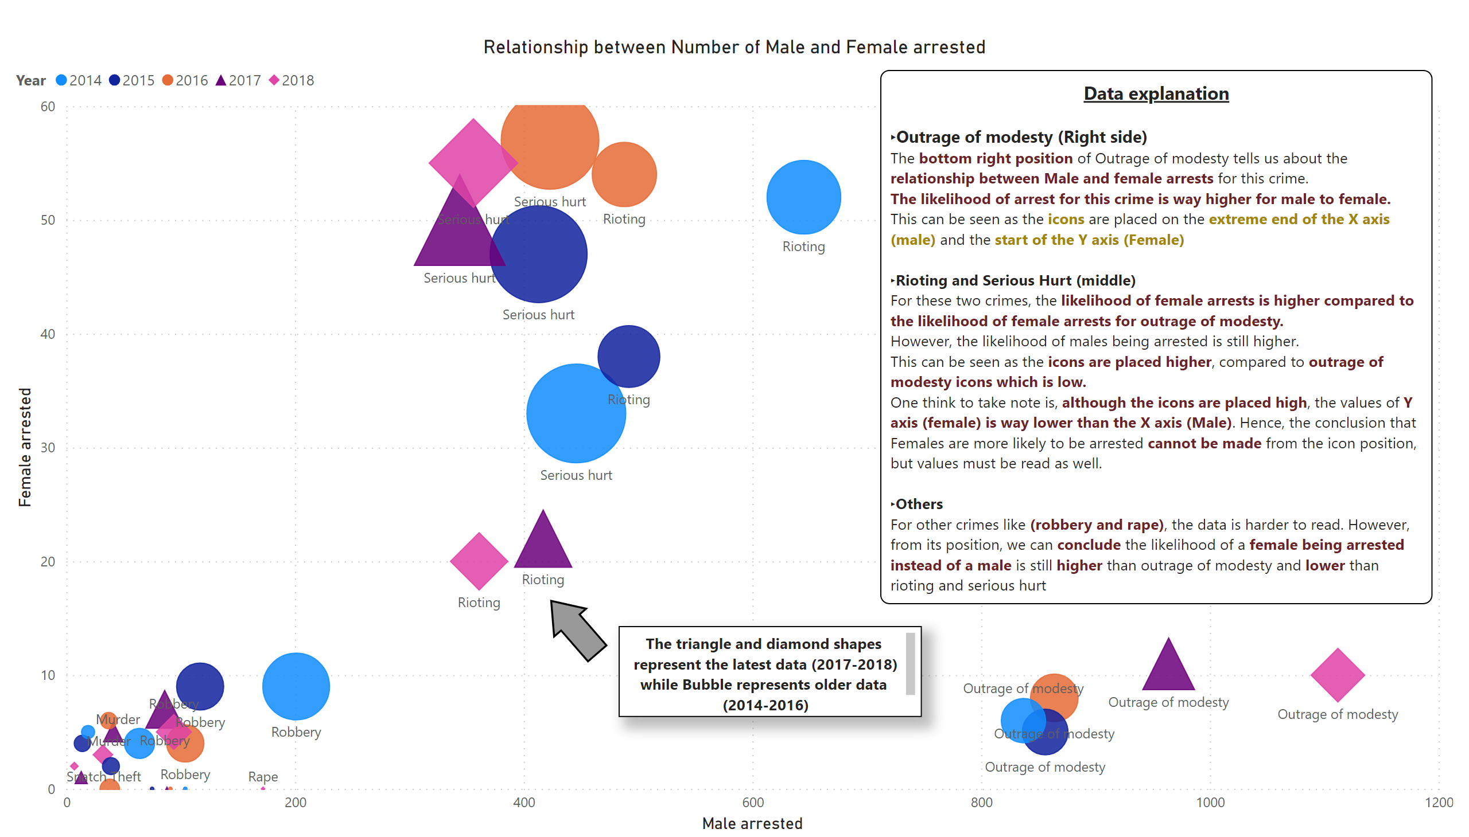
Rls between male n female arrested
Notes:
Relationship between Number of Male and Female arrested
No alt text provided
textbox
No alt text provided
textbox
No alt text provided
basicShape
No alt text provided

Slide 8
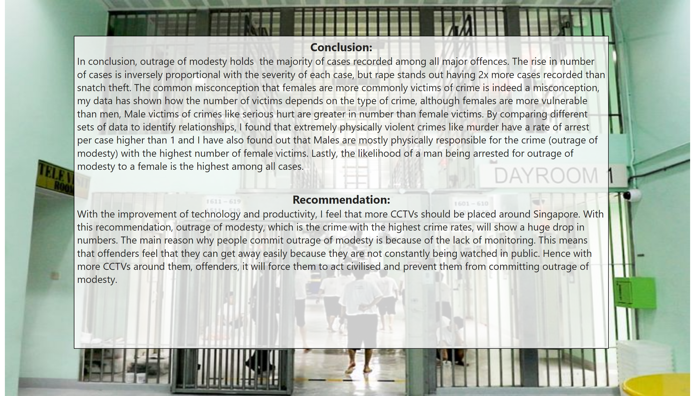
Page 2
Notes:
textbox
No alt text provided

Slide 9
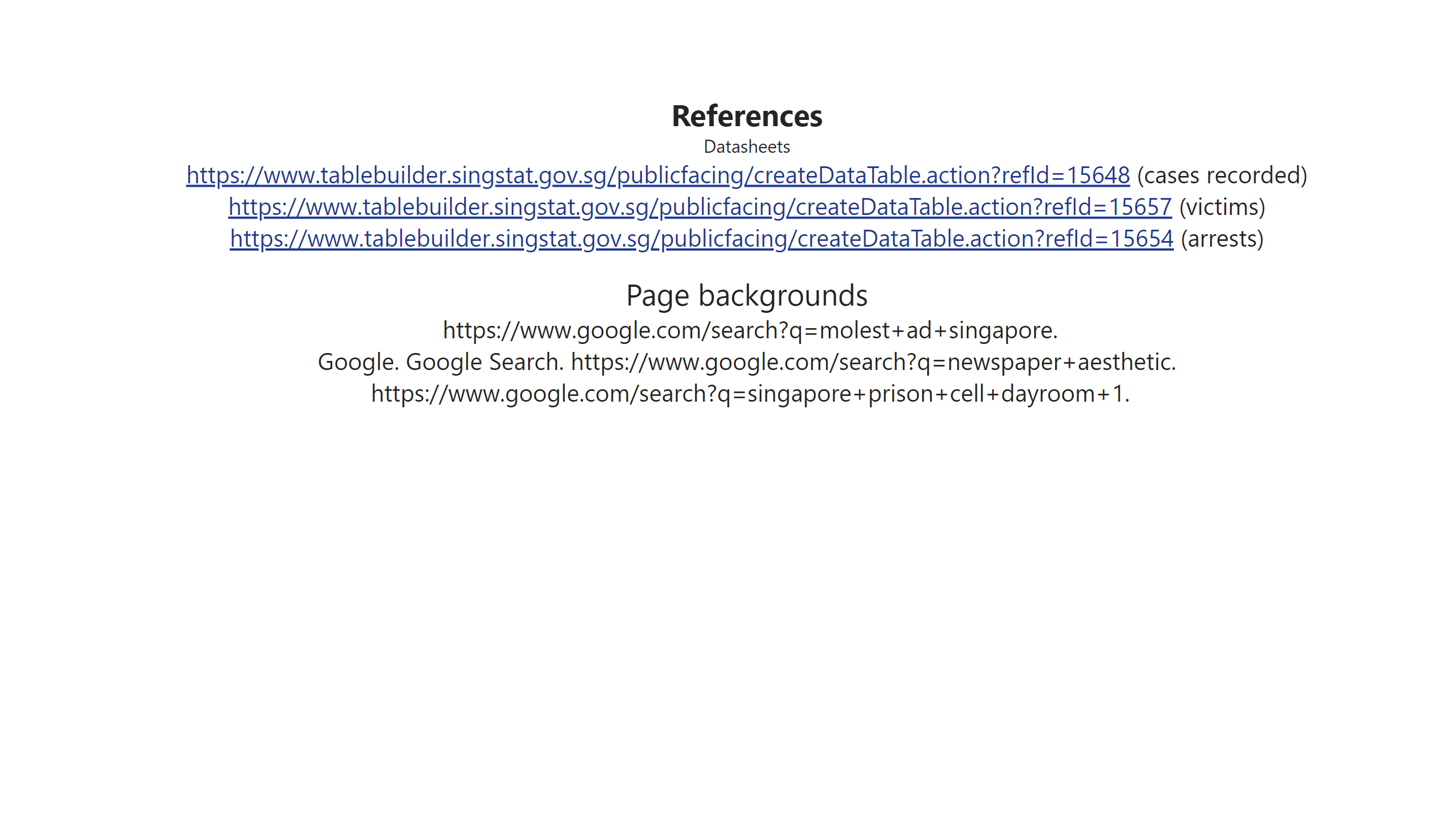
Page 3
Notes:
textbox
No alt text provided

